Slide 1
Looking back, peering ahead
Ramakrishna Kotla
Microsoft Research, Silicon Valley

Slide 2
AND I AM A PC TOO…..
Notes:
Today’s talk is not about why PCs are cool but …..

Slide 3
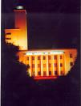

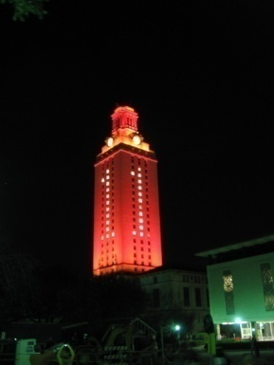
To learn the road ahead, ask those who are coming back
1994-1998: Undergraduate (IIT, Kharagpur)
2008: Researcher
1998-2001: R&D Engineer
2001-2007: PhD student (UT, Austin)
Notes:
In this talk, I will talk about my experiences as to why I chose research as a career and how I got to where I am today. And hopefully, you will find some points interesting and perhaps, useful as well. I will not be able to cover everything in detail in 20 minutes but instead I will try to highlight the important things. So, please feel free to ask me questions during or at the end of the talk if you want me elaborate on something particular. I will start with my background first,……

Slide 4
Why didn’t I do PhD after undergrad ?
Enjoyed building systems
  Writing papers was not appealing
Not sure about the area: Vision, systems,…
  Project: Character recognition system
  Interested in computer architecture, OS
Money: Golden internet days
Notes:
I did not go for a PhD after completing my undergraduate studies at IIT……

Slide 5
Why did I do PhD later?
R&D Engineer: More of D than R
  Mostly bringing yesterday’s technology to reality
PhD is (almost) a requirement for researcher
  To learn and advance the state of the art
End of golden days: Internet bubble burst
Notes:
After working for 3 years at Synopsys and learning new things, I realized that I was doing more of development than research.
In fact, there was an impressive research group led by Kurt Kuetzer, who is a professor now at UC Berkeley, but they employed only top PhDs………

Slide 6
What did I learn during my PhD?
Knowledge: Become an expert in your area
  Research agenda, writing papers, giving talks
  How to become a “better” researcher?
Wisdom: Lessons for life
  PhD is an approximate snapshot of your life
  How to become a “better” human being?

Slide 7
What is the secret sauce?
“I can think, I can wait, and I can fast”
  Siddhartha, by Hermann Hesse (Nobel laureate)
Think: Think through the things
Wait: Be patient, your moment will come
Fast: Work hard, do not lose focus

Slide 8
Why did I choose research labs?
Make an impact
  Test your ideas on deployed systems
  Test your model with real workloads
  Build systems that people use
Freedom to work on new ideas
Do not worry about writing grants
  But support interns and visiting faculty

Slide 9
How did I get there?
Interviewed: 4 research labs+3 semi-research
Three things decide your fate
  What your work speaks about you?
  What others speak about you/your work?
  How you speak about your work?

Slide 10
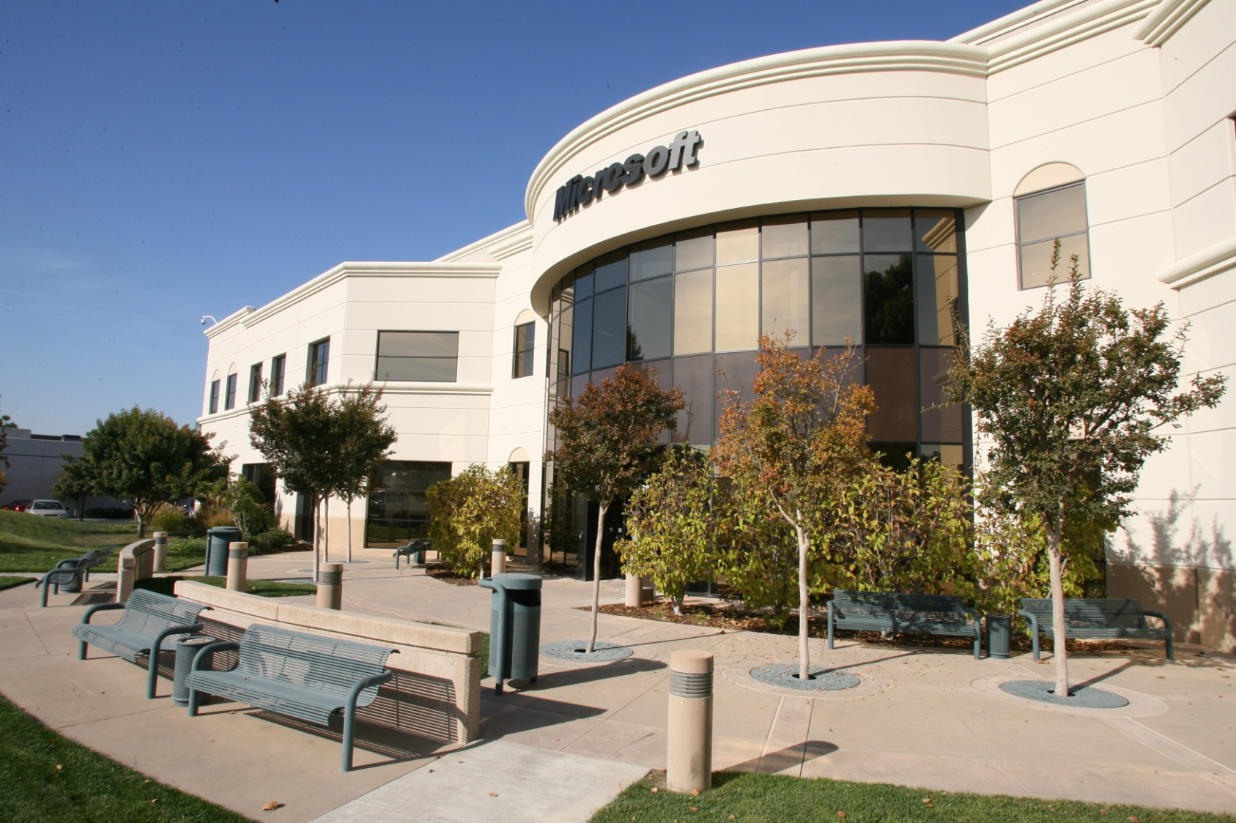
Where did I go?

Slide 11
Why did I choose MSR-SVC?
Focus: Advance state of the art in distributed computing
  Take interesting ideas to products
Philosophy: Collaborations over coffee
Run like an academic department
  Approximately similar size
  Flat in structure

Slide 12
Why did I choose MSR-SVC ?
Of course, talented colleagues
  Opportunity to work with smart interns
Matches top schools
  Top award recipients in the field
  Best paper awards in top conferences
  Publications (systems): 2 (out of 26) papers at OSDI’08, 4 (out of 32) papers at NSDI’09

Slide 13
What do I do now?
Nothing much different
  Work on problems, build systems, write papers
Interact with product groups
  Understand their problems
  Transfer ideas when possible
Academic service
  Review papers, give talks, serve on PCs

Slide 14
Conclusion
Successful PhD: Tenacity
  Think, work hard, wait
  “Many of life's failures are people who did not realize how close they were to success when they gave up."--Thomas A. Edison
Successful job search
  Good research, research style, communication skills

Slide 15
Questions?
Acknowledgements
  Roy Levin
  Doug Terry

Slide 16
BACKUP SLIDES

Slide 17
What do research labs seek?
Creativity
Curiosity
Technical breadth
Flexibility in area of work
System building skills
Passion
Independence
Perspective
Clarity in communication
Collaborative bent
Notes:
Creativity: can you come up with something new and interesting?
Curiosity: are you naturally interested in learning new things?
Flexibility: you will change your research focus several times in your career. Your PhD work will probably be uninteresting in 10 years, if not sooner.
Passion: Desire to “change the world”, willingness to go greater lengths to make your ideas a reality.
Independence: are you a self-starter? can you work largely unsupervised?
Communication: verbal and written skills
Perspective: on field and especially own PhD work

Slide 18
Corporate vs. Academic Research
Funding may depend on relevance to business
Patents generally encouraged
Publication is of varying importance
Non-personnel resources are usually available as needed
External collaborations affected by corporate IP strategy
Typically no management responsibility initially
Flat or hierarchical organization
Teaching possible, but optional
Consulting with product groups is part of the job
Advancement based on impact (generally products)
Funding based on agency criteria (generally broader)
Patents optional
Publication is mandatory
(for tenure)
Non-personnel resources are often constrained
External collaborations minimally constrained
May need to manage graduate students from the outset
Generally flat organization
Teaching generally mandatory
Consulting with industry is optional, and often attractive
Advancement based on professional standing

